Slide 1
Roadmap
11
12
13
14
15
16
17
18
19
20
21
22
23
24
Outline
Data Gathering
Scope Lock-in
Milestone 1
Milestone 2
Milestone 3
Milestone 4
Presentation
Rough draft of code
Front End
Combine all data
Presentation
Tools / Languages
Division of Parts

Slide 2
OPTION#2 (Chosen)
EV
Popularity of EVs across a certain area
Sales
Popularity of certain brands
Government incentives
Rise of demand and government mandated look-ahead
Charging Stations
Affordability
Mapping out charging stations across Canada
ChargeHUB
HUMMER?
US based data only (priority)
Questions:
Is it time to invest in an EV? Is it a WISE investment?
Charging station requirements based on EV locations, populations, etc.
Charging station location vs government affiliations
EV sales over the last 5 years(?) (milestones; Russian war, external factors), and look-ahead
Impact of EVs on climate change (Gas powered car vs EV in terms of emissions)
Difference in impact between different EV types
Comparison between EV brands on efficiency, range, etc.
How many Denny’s/Tim Hortons are there vs Charging Stations?

Slide 3
Element #1: Map to Showcase EV Popularity and Charging Station availability
Dataset on EV popularity
States by party affiliation
Dataset on Charging Station Location
Dropdown Menu:
EV Popularity
Charging Station
Gov. Affiliation
HTML
MAP
Javascript
Use a library that we haven’t used before
Python
Owner: Jason

Slide 4
Element #2: Showcase of Alternative Energy Strategies
1. Map of alternative fuel station locations
2. Graph to showcase the impact of the alternative fuel
Dataset with Count of stations per State
Dataset with Barrel of fuel used per year
Dropdown Menu:
Electric
Biodiesel
CNG, etc
Dataset with History of stations per State from 2007-2021
Dataset with location of electric and alternative fuel charging locations
MAP
Graph
HTML
or
Javascript
Graph
Python
Owner: Hardik

Slide 5
Element #3: Graph to Showcase the efficiency comparison of each EV brand
Dataset with Efficiency of Cars
Comparison:
Charging Time
Range
Performance
Affordability
Top 10
Dropdown Options
Graph (Bar, Line)
Compare different types of electric vehicles
HTML
Javascript
Python
Owner: Anna

Slide 6
Element #4: Sales of EVs
Dataset with Sales of EVs
Dropdown by Model
Need Sales data for US
Top 10
Graph
HTML
Javascript
Python
Owner: Anna

Slide 7
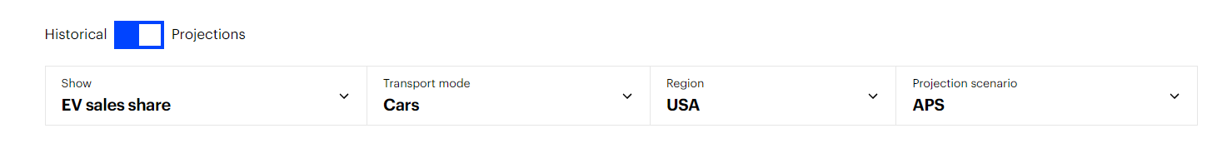
Element #5: Environment Impact
Dropdown
Global EV Data Explorer
Hardik’s Files
Graph
HTML
Javascript
Python
Owner: Arsam

Slide 8
Element #6: Denny’s
Denny’s Location
SQL
MAP
Owner: Arsam

Slide 9
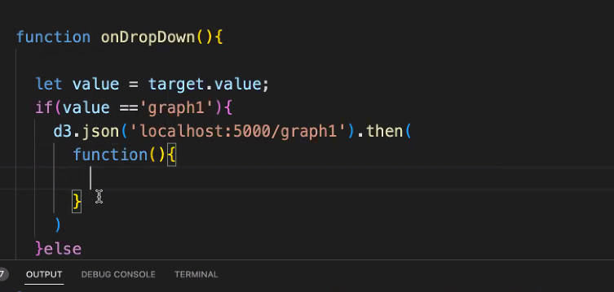
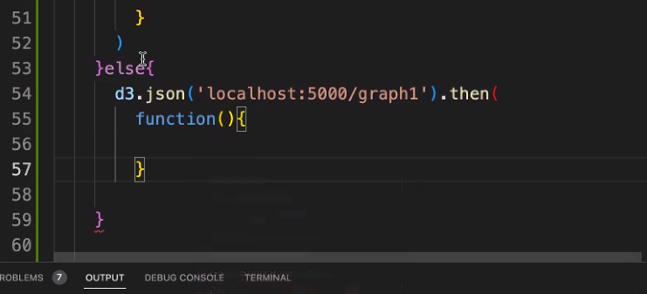
Brainstorming:
schools; at capacity schools need relief. A tool for parents to evaluate if a school is a good fit. (mappable)
- Unique
- What it means to be a good fit? Hard question – Provide information for parents to evaluate the schools based on testing score, proximity, a certain personal (family) criteria
Car theft; where about, model, why Toyota or Honda, difference in car security systems. (mappable)
Car performance; consumer reports
EV Data;
Real Estate; neighbor, walking score
- need to diversify
Unique topic. Cool way of using data.

Slide 10
OPTION#1
School Criteria
Testing scores (samples 2-3)
School enrollments
Safety (crime rates at the particular area)
Sports
Area population
Private or Public or both

Slide 11
Project Deliverables
Your visualization must include a Python Flask-powered API, HTML/CSS, JavaScript, and at least one database (SQL, MongoDB, SQLite, etc.).
Your project should fall into one of the following three tracks:
A combination of web scraping and Leaflet or Plotly
A dashboard page with multiple charts that update from the same data
A server that performs multiple manipulations on data in a database prior to visualization (must be approved)
Your project should include at least one JS library that we did not cover.
Your project must be powered by a dataset with at least 100 records.
Your project must include some level of user-driven interaction (e.g., menus, dropdowns, textboxes).
Your final visualization should ideally include at least three views.

Slide 12
To do list:
Main Page:
Replace tags-done
Improv title, and add group information - done
Create links to all other tags - done
4. Save and link other group files - done
5. Add backgrounds to graphs - CAN’T COMPLETE. Plotly takes up whole page
6. Slides (Friday) – completed without effects – Anna and Hardik to add their parts
7. Add topo (CAN’T DO IT)
8. Custom markers (DONE. Only on the denny file, need to transfer over to the main file)
9. Pull data from query

